Slide 1


JEWELLERY APP
TEAM 3
Anjana Shankar
Bharath lakshmi
Jeswanth Ragu
Krishna Raju
Nageshkumar Srinivas
Sinchana Puttaswamy

Slide 2
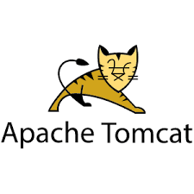
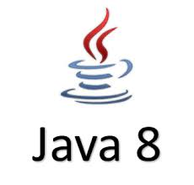
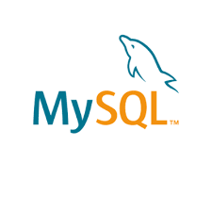



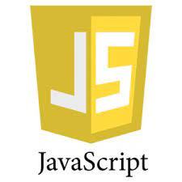
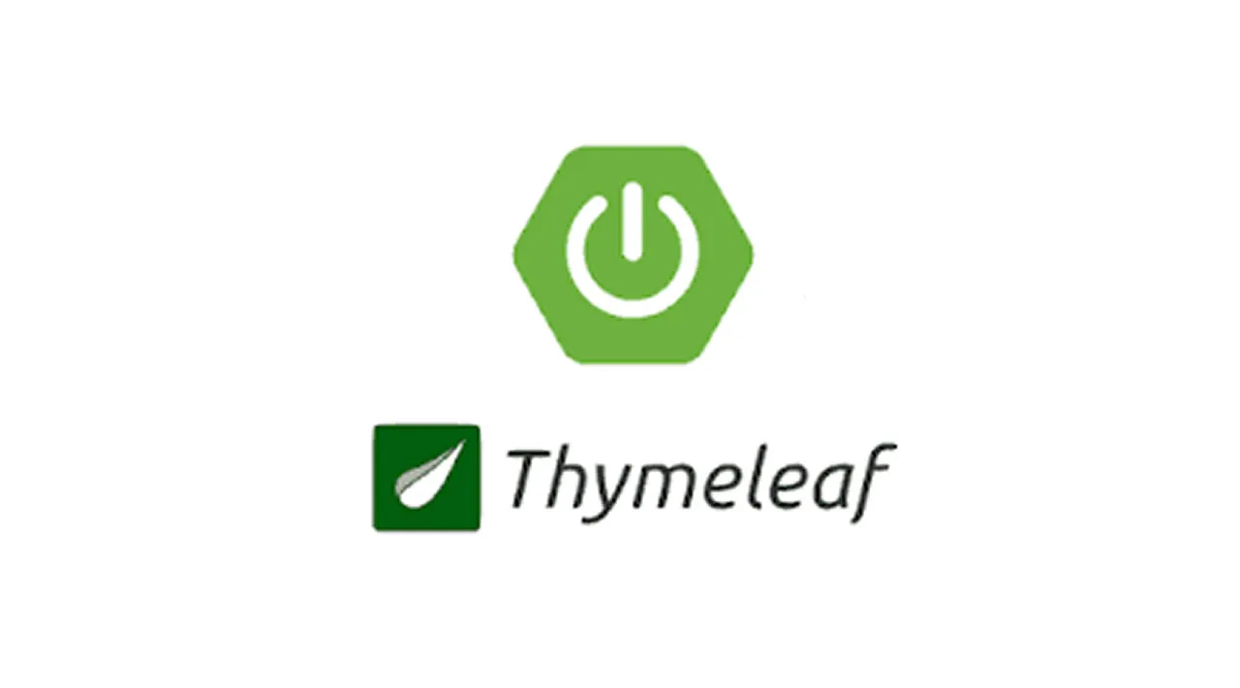
SYSTEM REQUIREMENTS

Slide 3
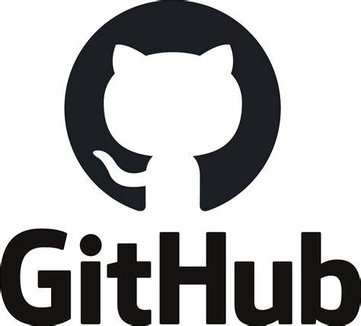

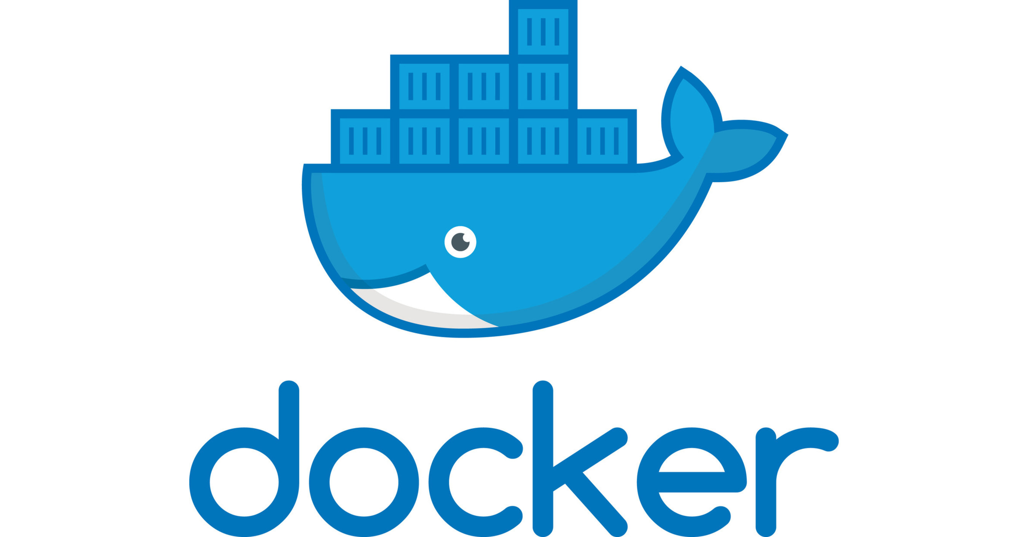
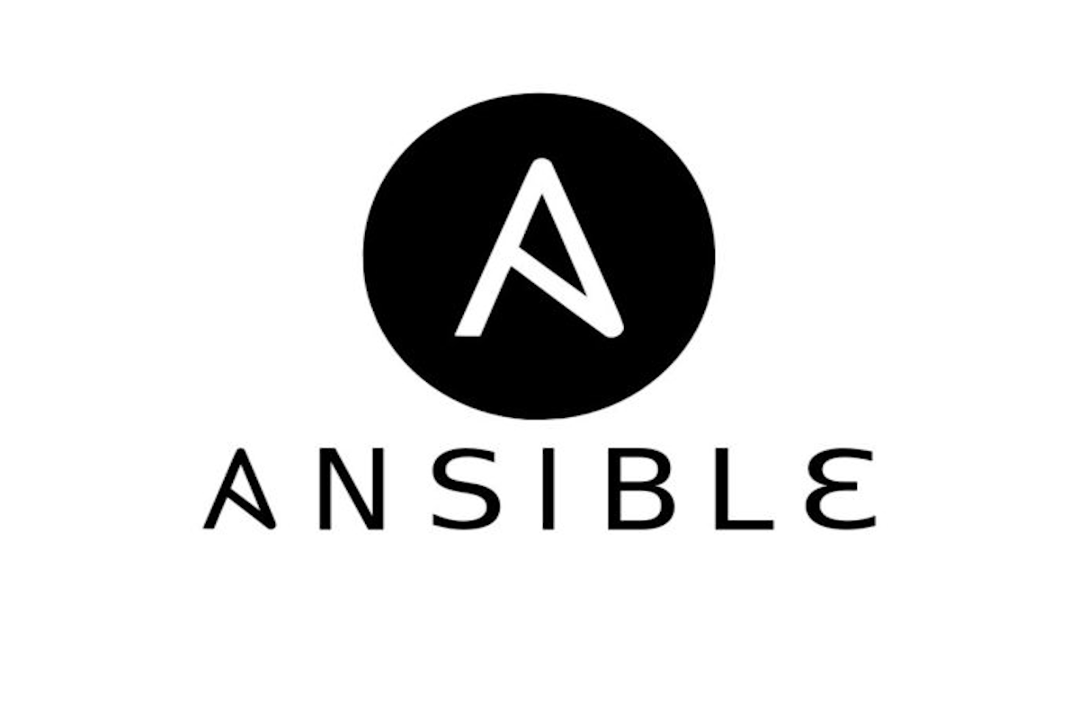

Nexus

Slide 4
FLOW OF THE PROJECT
REGISTER
LOGIN
HOME
SHOP
CART
ADMIN
SUPPORT
CART
VIEW PRODUCT
CHECKOUT
UPDATE
DELETE
SEARCH RESULTS
CATEGORIES

Slide 5
FLOW CHART ON BACKEND
MODEL
REPOSITORY
SERVICE
CONTROLLER
DTO
GLOBALDATA
CONFIGURATION

Slide 6
DEVOPS
The term DevOps is a combination of two words namely Development and Operations.
DevOps is a practice that allows a single team to manage the entire application development life cycle, that is, development, testing, deployment, and monitoring.
The DEVOPS tools which we implemented in our project are:
GitHub
Docker
Jenkins
Nexus

Slide 7
GITHUB
What is GitHub?
GitHub is a Git repository hosting service that provides a web-based graphical interface.
It is the world’s largest coding community.
Putting a code or a project into GitHub brings it increased, widespread exposure.
Programmers can find source codes in many different languages and use the command-line interface, Git, to make and keep track of any changes.
Why GitHub?
Easier version control
Repository
Gist
Collaboration tool
Perfect open-source platform

Slide 8
GitHub commands used in our Project
$ git config --global user.email "[valid - email]"
- This command is used for login into the git repository.
$ git init
- This command is used to create empty repository.
$ git add .
- This commands is used to stage the changes.
$ git commit – m "commit the changes"
- This command is used to commit the changes .
$ git pull "Repository link"
- This command is used to fetch and download content from a remote repository.
$ git push "Repository link"
- This command is used to upload contents from local repository to remote repository.

Slide 9
DOCKER
DOCKER tool is designed to make it easier to create, deploy and run application by container.
How does Docker work ?
Docker packages an application and all its dependencies in a virtual container that can run on any server.
So it will always work the same regardless of its environment
Image:
Image is a read-only template with instructions for creating a Docker Container.
Container:
It is a runnable instance of an image.

Slide 10
Commands to create the docker container
Git clone "Github-link.git"
- This command is used to clone the project from the GitHub repository .
TO CREATE THE DOCKERFILE:
FROM openjdk:8
- This command initializes a new build stage and sets the Base Image for subsequent instructions
ADD target/thbs-jewellery.jar thbs-jewellery.jar
- This command is used to copy files/directories into a Docker image
EXPOSE 8087
- This command is to use the –expose flag at runtime to expose a port.
ENTRYPOINT ["java","-jar","thbs-jewellery.jar"]
- This command is used to set executables that will always run when the container is initiated

Slide 11
Cont.....
Now go to the location of the docker file (root)
TO CHANGE THE APPLICATION.PROPERTIES :
spring.jpa.hibernate.ddl-auto=update
spring.datasource.url=jdbc:mysql://${MYSQL_HOST:localhost}:${MYSQL_PORT:3306}/jwellery
spring.datasource.username=${MYSQL_USER:root}
spring.datasource.password=${MYSQL_PASSWORD:Jeswanth@2000} server.port=8088
-This entire part must be replaced in the application.properties in the springboot project this is changed to link with the mysql container
mvn clean package
- This command is used to create a .jar file in the target folder .
docker build –t jewelleryapplication .
- This command will build the image of the springboot application.

Slide 12
Cont.....
docker pull mysql:latest
- This command is to pull the mysql latest version from the docker repository hub.
docker run –d –p 3307:3306 –name mysqldb –e MYSQL_ROOT_PASSWORD=root
-e MYSQL_DATABASE=jewellery mysql
- This command is used to run the mysql image inside the container mysqldb in detached mood.
docker ps
- This command is used to list the running containers.
docker network create springnet
- This command is used to create a network.
docker network connect springnet mysqldb
- This command is used to connect network(springnet) to the mysqldb(container)

Slide 13
Cont.....
docker inspect mysqldb
- This command is used to inspect mysqldb(container) to check whether the network connection is exists or not.
ENV FILE Creation:
MYSQL_HOST=mysqldb MYSQL_USER=root MYSQL_PASSWORD=Jeswanth@2000 MYSQL_PORT=3306
Docker run –p 8089:8088 –name jewellaryApp –net springnet(network) --env-file env jewelleryapplication
- This command is used to create and the run the springboot container in the name of the jewellaryApp.
- This container will run with the help of springnet(network) and the env file which we have created earlier.
- In the browser we can put the localhost then we can see our entire project running.

Slide 14
Jenkins
What is Jenkins?
The leading open-source automation server, Jenkins provides hundreds of plugins to support building, deploying and automating any project.
Why Jenkins?
Immediate feedback on broken builds.
No building from development machines and manually copying files.
Automated deployment.
Automated test execution and feedback.
Open source.
CI/CD.

Slide 15
Pipelines​
It is a collection of events or jobs which are interlinked with one another in sequence.
It is a combination of plugins that supports the integration and implementation of continuous delivery pipelines using Jenkins.
There are two types:
1.Scripted(Groovy).
2.Declarative.

Slide 16
Pipeline Creation
Install all these plugins from manage plugins.
Nexus artifact uploader
Nexus platform plugin
Maven artifact choice list provider
Maven integration plugin
Maven invoker plugin
Maven metadata plugin for Jenkins
Maven repository server plugin
Maven dependency update trigger
Maven repository scheduled cleanup plugin
Maven info plugin
Maven deployment linker
Pipeline utility steps
Pipeline maven integration plugins

Slide 17
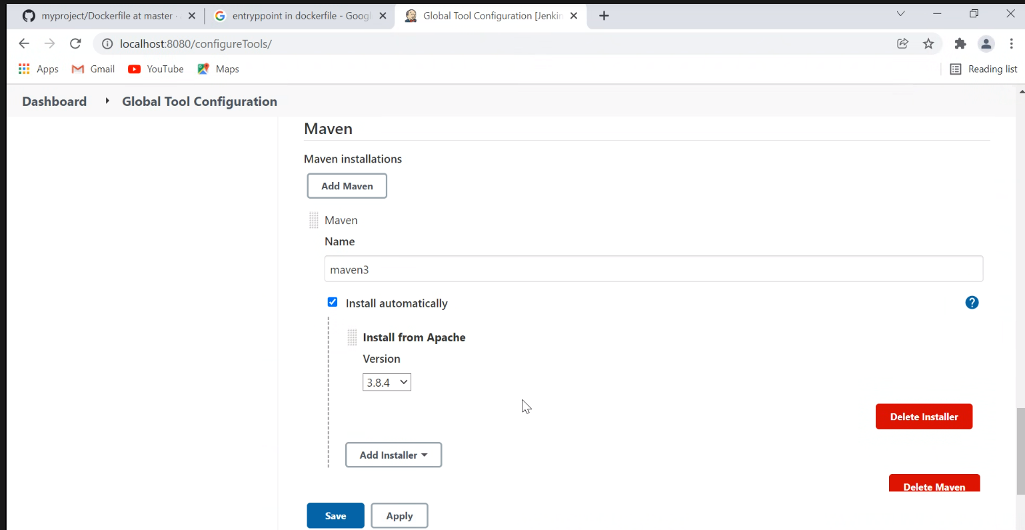
In Global tool configurations.

Slide 18
Next create a Jenkinsfile in the Github. This file is to run the Jenkins.
pipeline {
agent any
tools {
// Install the Maven version configured as "M3" and add it to the path.
maven "maven3"
}
stages {
stage('Build') {
steps {
// Get some code from a GitHub repository
git 'https://github.com/ab382/myproject.git'
// Run Maven on a Unix agent.
sh "mvn -Dmaven.test.failure.ignore=true clean package"
// To run Maven on a Windows agent, use
// bat "mvn -Dmaven.test.failure.ignore=true clean package"
}

Slide 19
post {​
// If Maven was able to run the tests, even if some of the test​
// failed, record the test results and archive the jar file.​
success {​
junit '**/target/surefire-reports/TEST-*.xml'​
archiveArtifacts 'target/*.jar'​
}​
}​
}​
stage('run') {​
steps {​
// Get some code from a GitHub repository​
git 'https://github.com/ab382/myproject.git'​
​
// Run Maven on a Unix agent.​
sh "mvn spring-boot:run"​
​
// To run Maven on a Windows agent, use​
// bat "mvn spring-boot:run"​
}​
}​
}​
}​

Slide 20
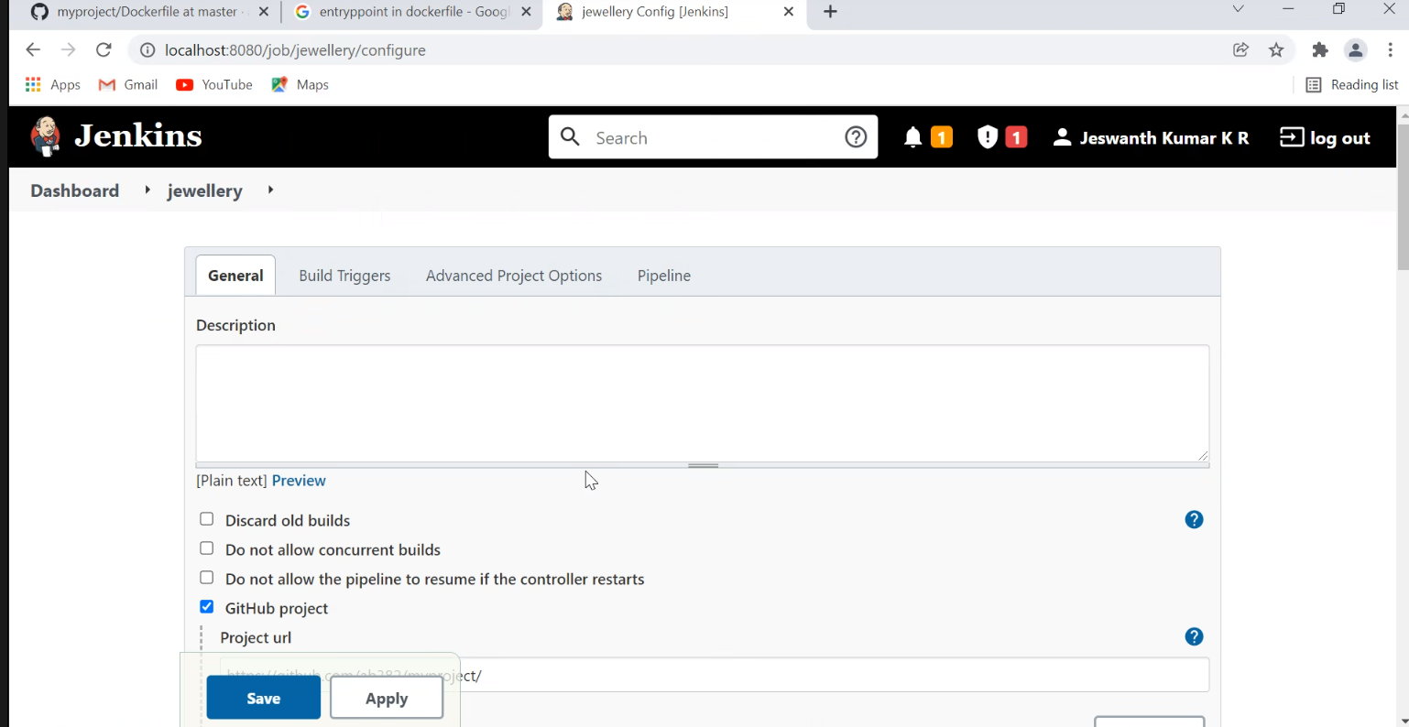
Now we have set up maven and all its plugins.
Create a new item, name this as jewellery and select pipeline.

Slide 21
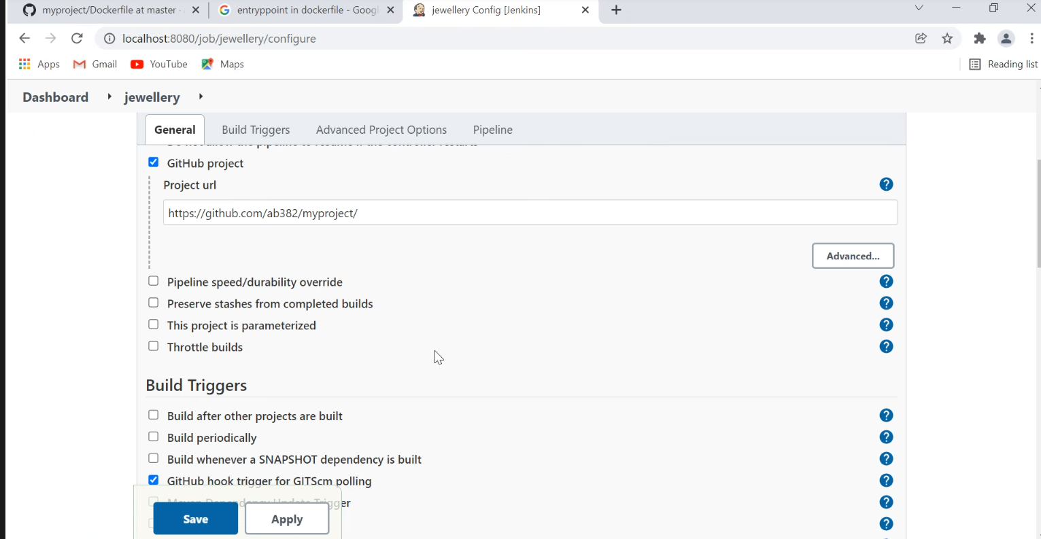

Slide 22
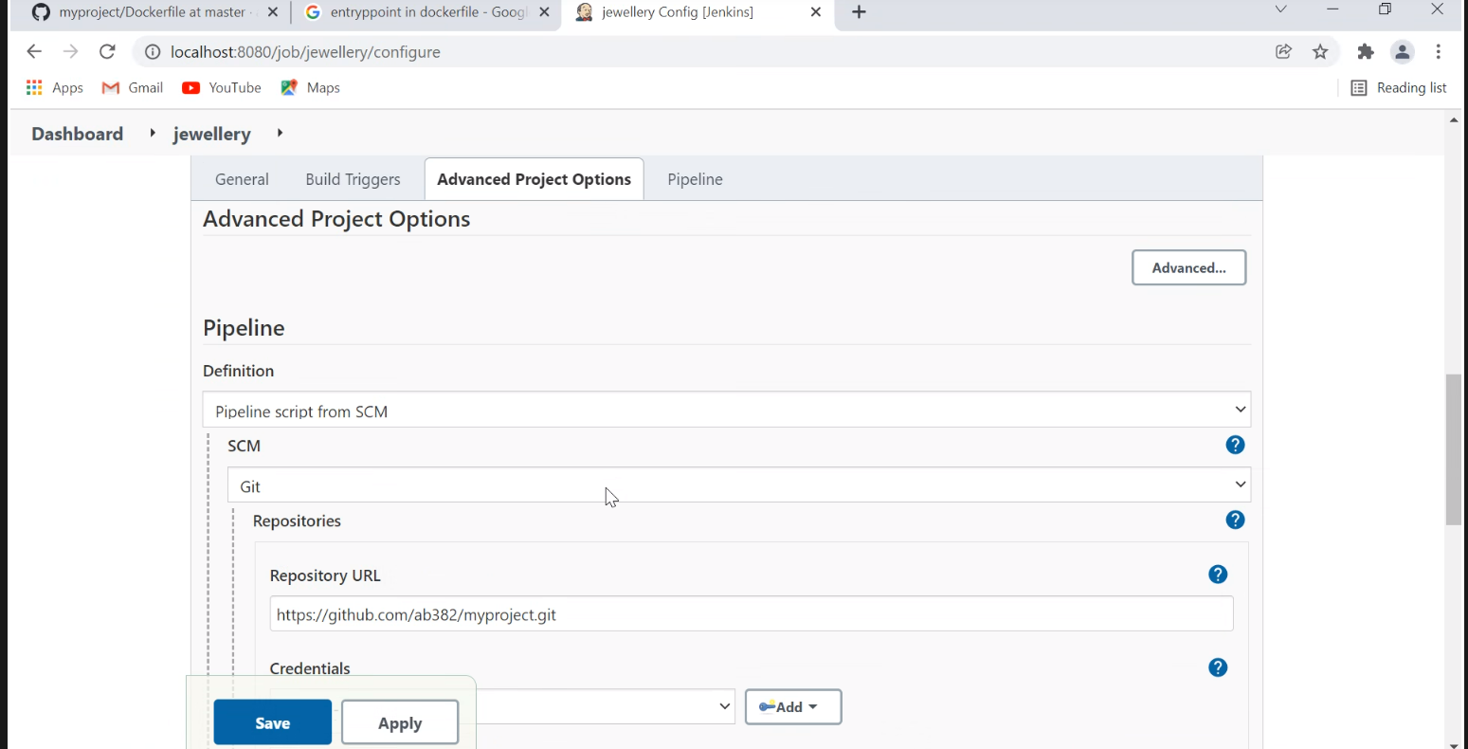

Slide 23
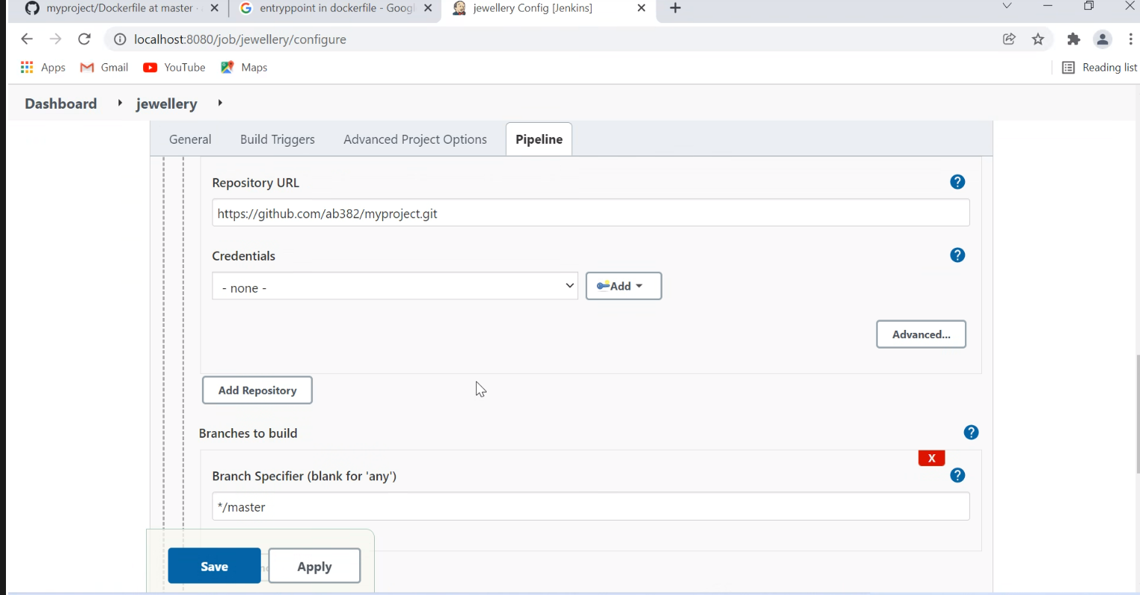

Slide 24
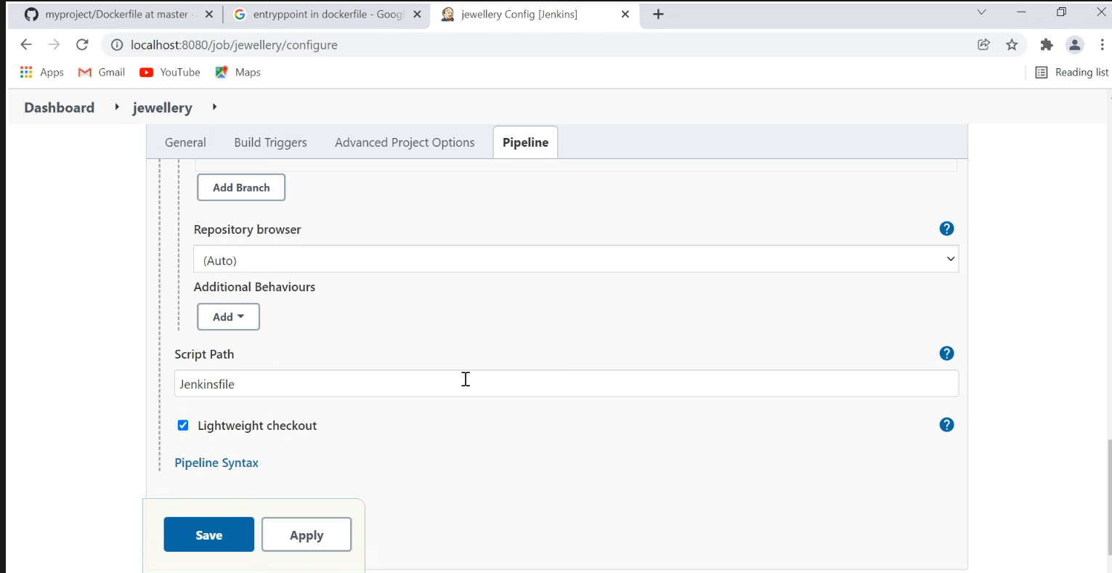

Slide 25
Nexus
What is nexus ?
Nexus Repository OSS is an open-source repository that supports many artifact formats, including Docker, Java™, and npm.
With the Nexus tool integration, pipelines in your toolchain can publish and retrieve versioned apps and their dependencies by using central repositories that are accessible from other environments.
Why nexus?
Nexus is a repository manager. It allows you to proxy, collect, and manage your dependencies so that you are not constantly juggling a collection of JARs.
It makes it easy to distribute your software.
Internally, you configure your build to publish artifacts to Nexus and they then become available to other developers.

Slide 26
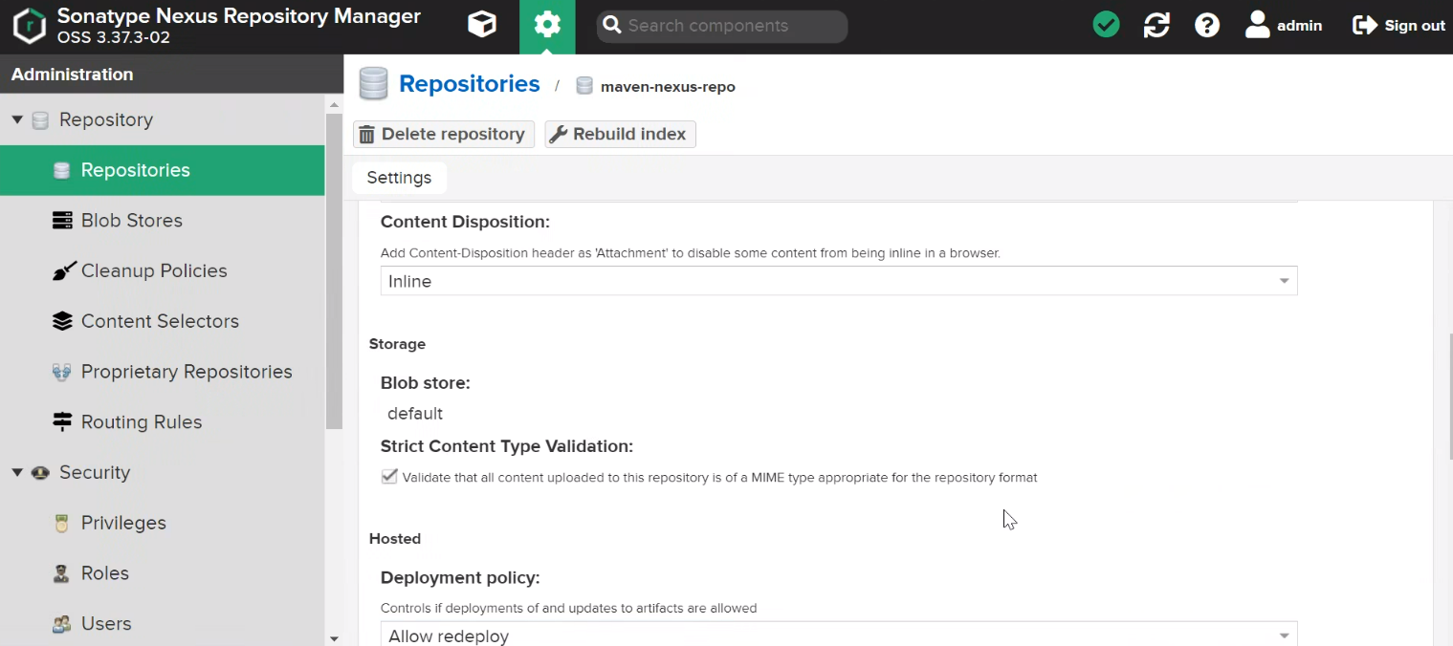

Slide 27
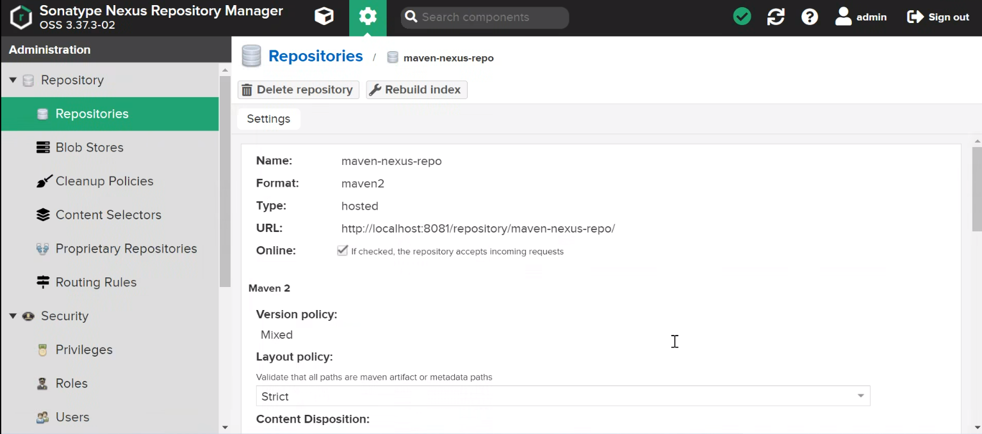

Slide 28
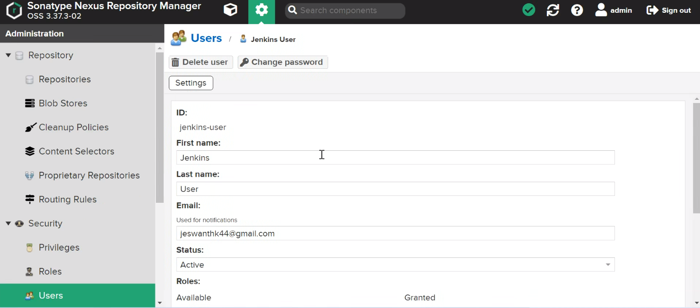

Slide 29
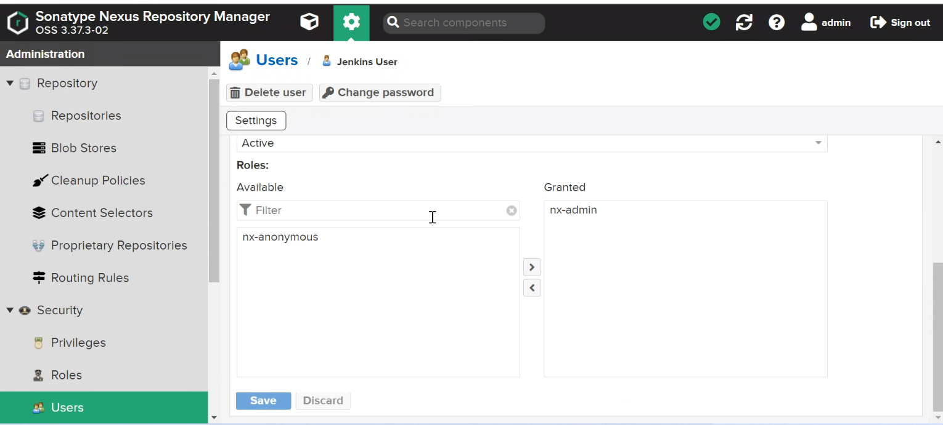

Slide 30
ANSIBLE
What is Ansible?
Ansible is an open-source IT automation engine that automates provisioning, configuration management, application deployment, orchestration, and many other IT processes.
Why Ansible?
Ansible automates and simplifies repetitive, complex, and tedious operations. Everybody likes it because it brings huge time savings when we install packages or configure large numbers of servers. Its architecture is simple and effective. It works by connecting to your nodes and pushing small programs to them.

Slide 31
Cont.....
Why we use ansible in devops?
Ansible helps us to automate server and cloud provisioning, configuration management, and application deployment.
ANSIBLE PLAYBOOK:
---
- name: Update all the packages and Install Git, Java, Docker, in our aws EC2 instance.
hosts: all
become: yes
tasks:
- name: updating all the system packages
apt:
name: “*”

Slide 32
Cont.....
state: latest
update_cache: yes
- name: installing Git
apt:
name: git
state: latest
update_cache: yes
- name: installing Java
apt:
name: openjdk-8-jdk
state: latest
update_cache: yes
- name: installing Docker
apt:
name: docker.io
state: latest
update_cache:yes

Slide 33

THANK YOU

